Slide 1



DEPARTMENT OF ELECTRONICS AND COMMUNICATION ENGINEERING
PROTECTION OF CROPS AGAINST BIRDS & ANIMALS USING SENSOR BASED SYSTEM
TEAM MEMBERS
1. JAINISHAANTH N S
2. KIRUTHIVARMA S
3. MUTHUKUMAR S 4. NANDHAKUMAR M
GUIDED BY
Mrs.T.BALAMANI

Slide 2

introduction
Protecting agricultural lands from the intrusion of birds and animals while simultaneously ensuring their welfare poses a significant challenge for farmers worldwide.
The Passive Infrared (PIR) sensor, as the cornerstone of our design. This sensor detects the presence of animals within a designated range and triggers a non-invasive alarm, emitting harmless frequencies specifically designed to deter them.
This project outlines our commitment to developing an innovative solution that not only protects agricultural resources but also promotes harmony between farming practices and the natural ecosystem
We have developed the Feedo app to monitor activities on farmland, making it a user-friendly tool for farmers.

Slide 3
problem statement
The persistent challenge faced by farmers in protecting agricultural lands from the intrusion of birds and animals while ensuring the well-being of wildlife. Traditional methods of deterrence often posed harm to these creatures, necessitating the development of a humane and effective solution.
The system architecture revolves around the utilization of a specialized Passive Infrared (PIR) sensor, strategically positioned to detect the presence of animals approaching the protected farming area.
Recognizing the importance of supporting wildlife, the system incorporates an automatic feeding and watering mechanism. This component ensures that animals within the vicinity have access to essential nourishment and hydration, thereby promoting their well-being even as they are redirected away from the agricultural areas.

Slide 4

ObJECTIVES
Cultivate crops in protected area
Sensor based Acoustic System
Automatic feed and water supply
Protecting Living Organisms ​

Slide 5
EXISTING RESEARCH
Existing studies have extensively addressed the challenge of deterring wildlife from agricultural landswhile ensuring their welfare.
These studies emphasize the need for effective deterrence methods that do not harm wildlife

Slide 6
abstract
Introduces a clever system that helps to protect farming lands from unwanted visitors, like birds and animals.
By using a special sensor called Passive Infrared (PIR) to detect when these creatures get too close. When they do, an alarm will sound to scare them away, but don't worry, it's a harmless sound at frequencies of 360 to 440 Hertz.
Our system can be powered by a battery or a solar panel, making it eco-friendly. The components used include steel wire for fencing, the PIR sensor, a battery, an alarm, an automatic feeder, a water supplier for birds, and an Arduino UNO for control.
In summary, this project provides a safe and effective way to deter birds and animals from your space while ensuring their well-being, all while being eco-conscious.

Slide 7
Sensor based Acoustic System
In the system we are using Passive Infrared(PIR) sensor – Produce alarm sound – Comes nearer to it in limited distances
The PIR sensor sends out rays that are picked up by a photodiode. These signals are then used to trigger an automatic feeding and watering system for the animals nearby. So, not only does it keep them away, but it also takes care of their needs.
High chances of diversion of Birds and Animals
Also produce alarm sound when birds are crossed

Slide 8
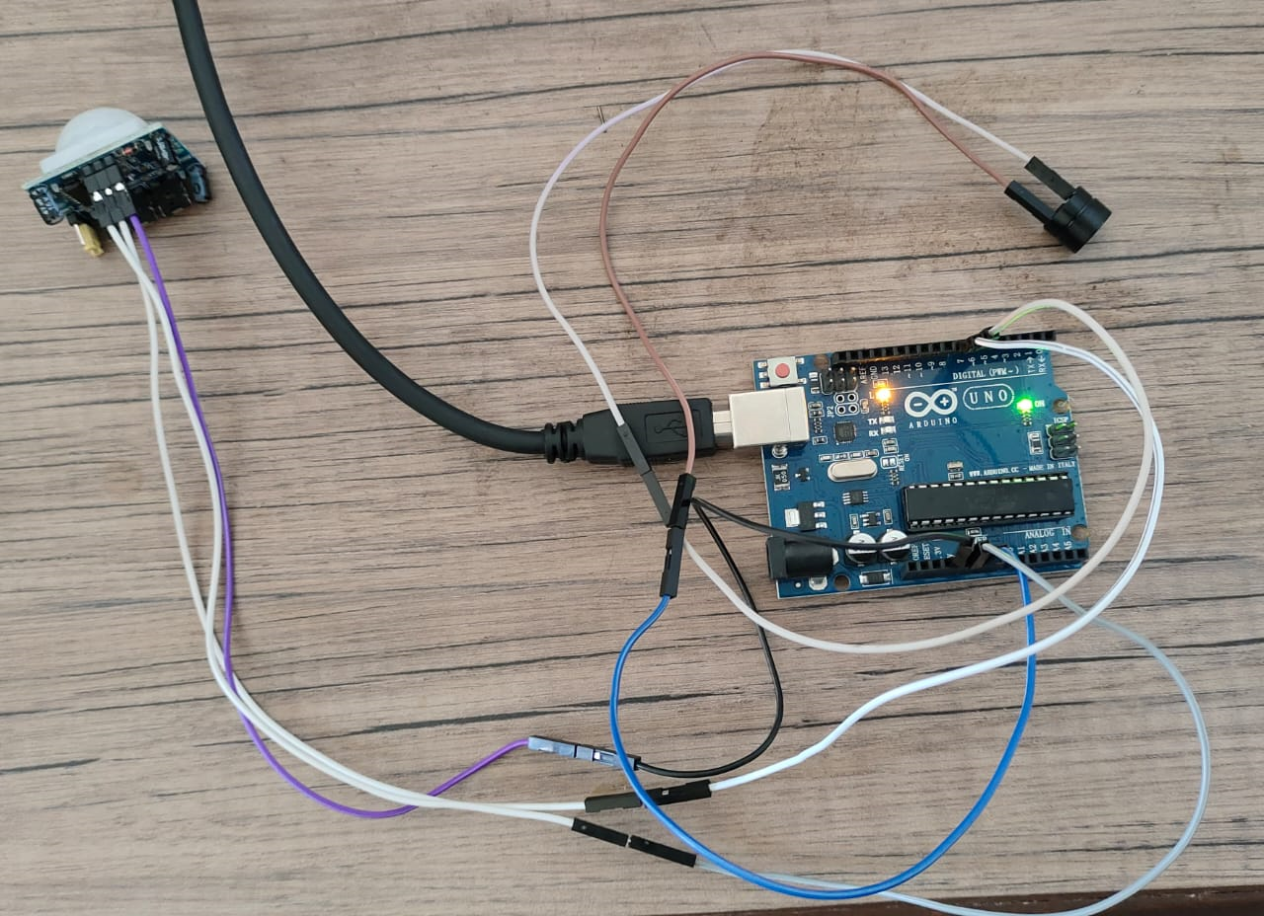
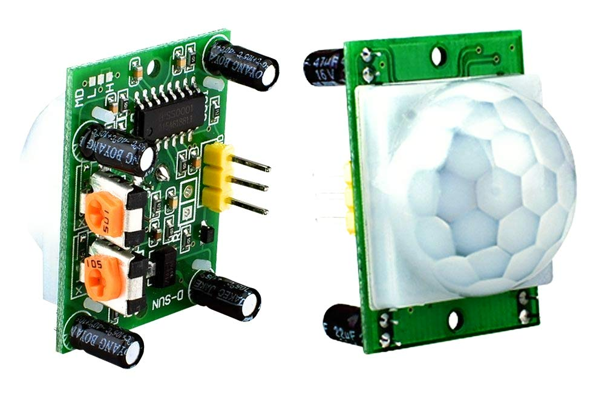
WORKING PRINCIPLE
The rays produced by PIR sensor – absorbed by photodiode – signals passes to automatic feed system – activate providing feed and drinking water – animals present near by
Source – Battery/ Solar Panel(12V)

Slide 9
FLOW CHART

Slide 10
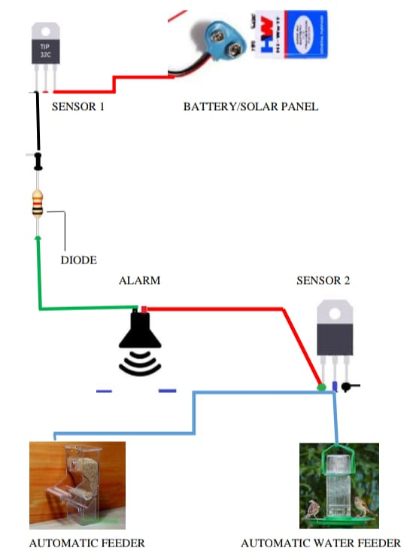
CIRCUIT DIAGRAM

Slide 11
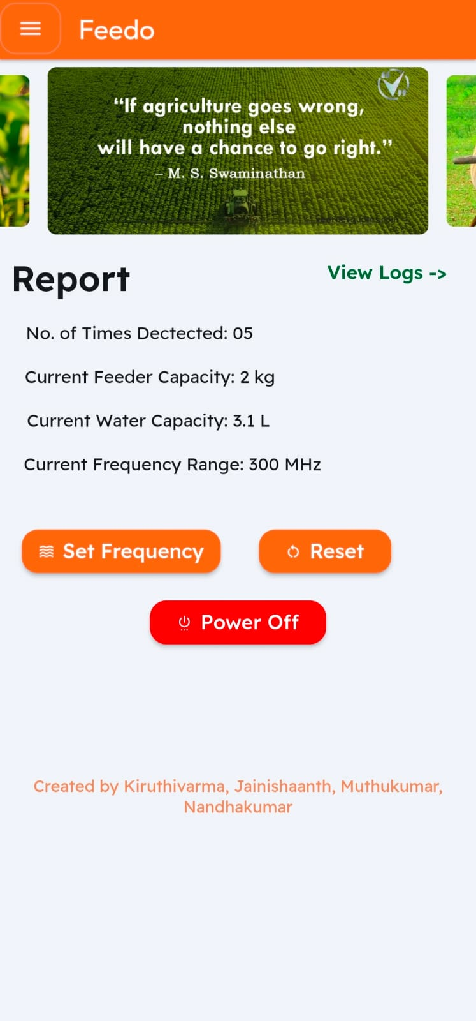
feedo
Feedo's combination of PIR (Passive Infrared) sensors, Arduino technology, and an accompanying app creates a comprehensive system for crop protection and monitoring.
The Feedo app acts as the centralized control and reporting hub. It connects to the hardware system, allowing farmers to remotely monitor their fields in real-time. The app displays detailed reports on intrusion incidents, providing valuable insights into the frequency, time, and specific locations of the intrusions.

Slide 12

benefits
Recent studies (Adams et al., 2019; Brown & Johnson, 2021) have emphasized the benefits of humane deterrence methods.
The use of harmless sound frequencies has shown promise in effectively deterring animals without causing harm. Such methods promote coexistence between farming activities and wildlife conservation, reducing crop damage while preserving biodiversity.

Slide 13

Advantages
This is farmer’s friendly and low cost
Harmless to living beings
Cares for the feed and drinking water supply of the birds and animals
Sound produced will be mild(360/440Hz)
Eco-friendly

Slide 14
THANK YOU!

